Slide 1
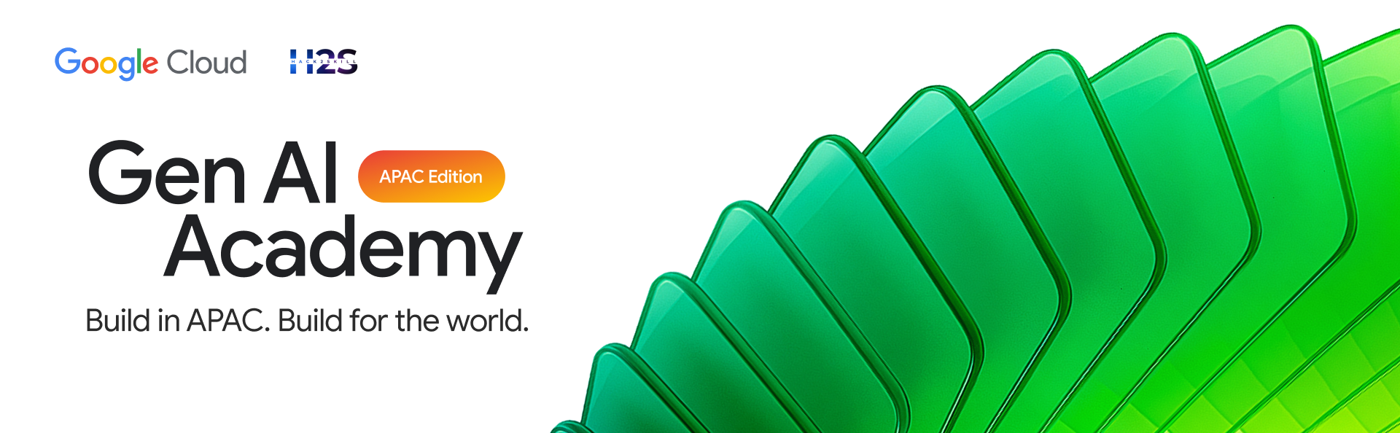
Participant Details
Participant Name: Ashwini Sharma
Problem Statement: F1 fans, analysts, and team strategists lack a unified tool to query historical race data, analyze telemetry, simulate pit strategies, and validate racing incidents against FIA regulations. Existing solutions are fragmented across multiple platforms, require deep technical expertise, and offer no way to cross-reference race performance with steward decisions or regulatory precedent — making real-time strategic insight inaccessible to most.

Slide 2
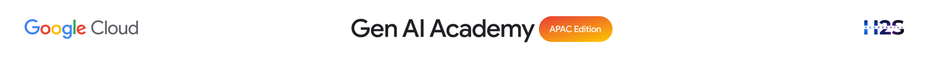
Brief about the idea
The F1 AI Orchestrator (Virtual Pit Wall) is a high-performance, two-tier multi-agent AI system. It delivers professional-grade F1 race strategy, live telemetry analysis, FIA regulation lookups, and steward decision precedents — all through natural conversation.
How it works:
Step 1 — You ask "Was the pit release at Bahrain 2024 legal, and how did it affect Verstappen's strategy?"
Step 2 — Coordinator routes: Race Engineer sequences the Steward Agent (FIA RAG lookup) + Performance Analyst (telemetry + Monte Carlo sim) in one pass, sharing data via session state
Step 3 — You get a report: Steward verdict · Regulation article cited · Pace delta · Tyre strategy simulation · Confidence score

Slide 3
How we translated the problem into a working solution
Agent orchestration: Two-tier hierarchy - race_strategist (Pit Wall Director) classifies every query as [SIMPLE] or [COMPLEX] and routes to f1_coordinator (Race Engineer), which sequences the right specialists and shares data via ToolContext.state - eliminating redundant FastF1 fetches.
Data fabric: AlloyDB (+ pgvector + ScaNN) stores 12 tables of historical race data (2020–2026) and 5,525 FIA regulation embeddings; FastF1 supplies live telemetry; Gemini 2.5 Flash (Vertex AI) powers reasoning with exponential backoff retry.
Tooling: Agents call deterministic tools (SQL queries, telemetry fetchers, RAG lookups, Monte Carlo executor, calendar writer) so outputs are auditable and reproducible.
Workflow: Natural-language query → Pit Wall Director classifies → Race Engineer sequences specialist(s) → Structured result (telemetry analysis, SQL, FIA ruling, Monte Carlo strategy sim, or .ics calendar).

Slide 4
Two-tier multi-agent design (4 specialists + Race Engineer coordinator + Pit Wall Director) with single-responsibility agents and zero-duplicate data fetches via ToolContext.state sharing.
RAG pipeline — 5,525 FIA regulation chunks + 664 steward decisions embedded with text-embedding-005 and indexed via AlloyDB ScaNN. No other conversational F1 tool offers regulatory precedent lookup.
Monte Carlo pit strategy simulator via Agent Engine Sandbox — live strategy simulations with probabilistic outcomes, not just historical lookups.
Calendar orchestration with .ics file generation (Google Calendar, Apple Calendar, Outlook) and per-session link table fallback.
SQL-aware LLM prompts using injected AlloyDB schema for safe, auditable queries.
USP
Real-time telemetry + historical modeling + FIA regulation RAG + Monte Carlo simulation + steward precedent search — in one conversational interface.

Slide 5
List of features
Natural-language telemetry comparisons (speed, throttle, brake, gear, RPM) across drivers and sessions.
Pit stop and stint analysis (lap-by-lap, tyre compound strategy, undercut/overcut detection).
Monte Carlo pit strategy simulation for podium/strategy shifts via Agent Engine Sandbox — probabilistic outcomes, not just lookups.
Head-to-head driver comparisons across seasons with AlloyDB coverage labels.
FIA regulation semantic search — fast 4-line steward verdict or full ruling on demand, via pgvector RAG over 5,525 regulation chunks and 664 steward decisions.
Google Calendar scheduling with .ics file generation (Google, Apple, Outlook) and per-session link table fallback.
React 19 + Vite 6 streaming UI with real-time SSE, per-agent attribution, and session resume.

Slide 8
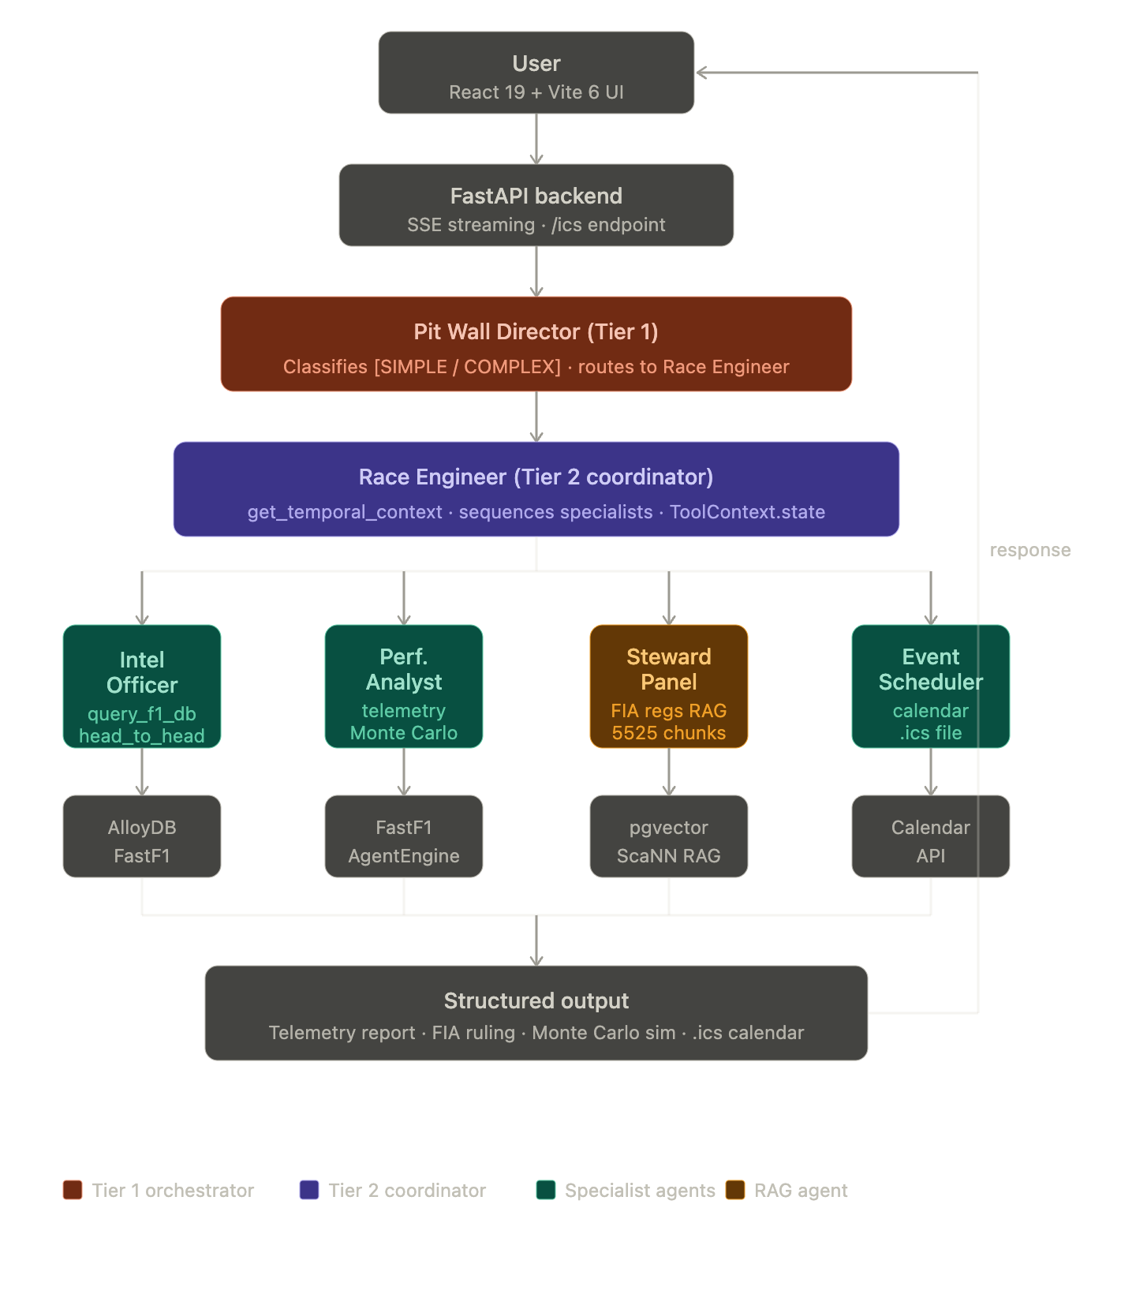
Architecture diagram of the proposed solution:

Slide 9
Technologies/Google Services used in the solution
Google GenAI ADK + Gemini (Vertex AI): Multi-agent orchestration and high-quality reasoning.
AlloyDB (Postgres-compatible): Low-latency historical queries and schema-driven SQL prompts.
FastF1: Live telemetry and session data for accurate modeling.
Cloud Run: Serverless container hosting for scalable, cost-effective deployment.
Google Calendar API: Direct-write scheduling and fallback link generation.
Scalability & deployment
Containerized services scale horizontally on Cloud Run; AlloyDB handles concurrent analytical queries; ADK agents are stateless LLM orchestrators with tool calls for deterministic I/O.

Slide 10
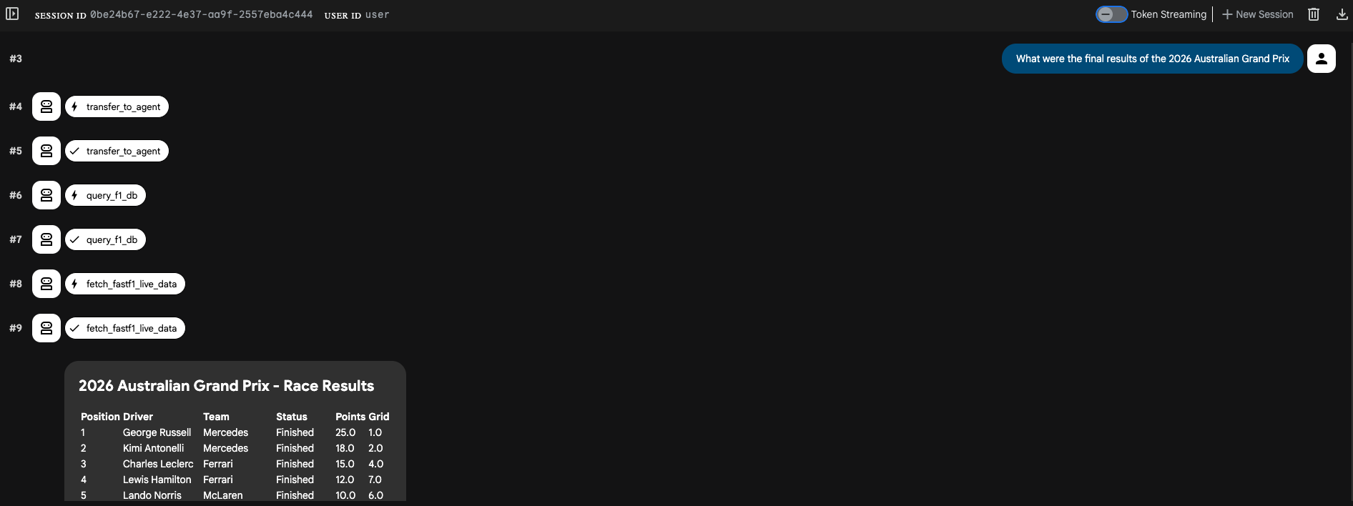

Slide 11
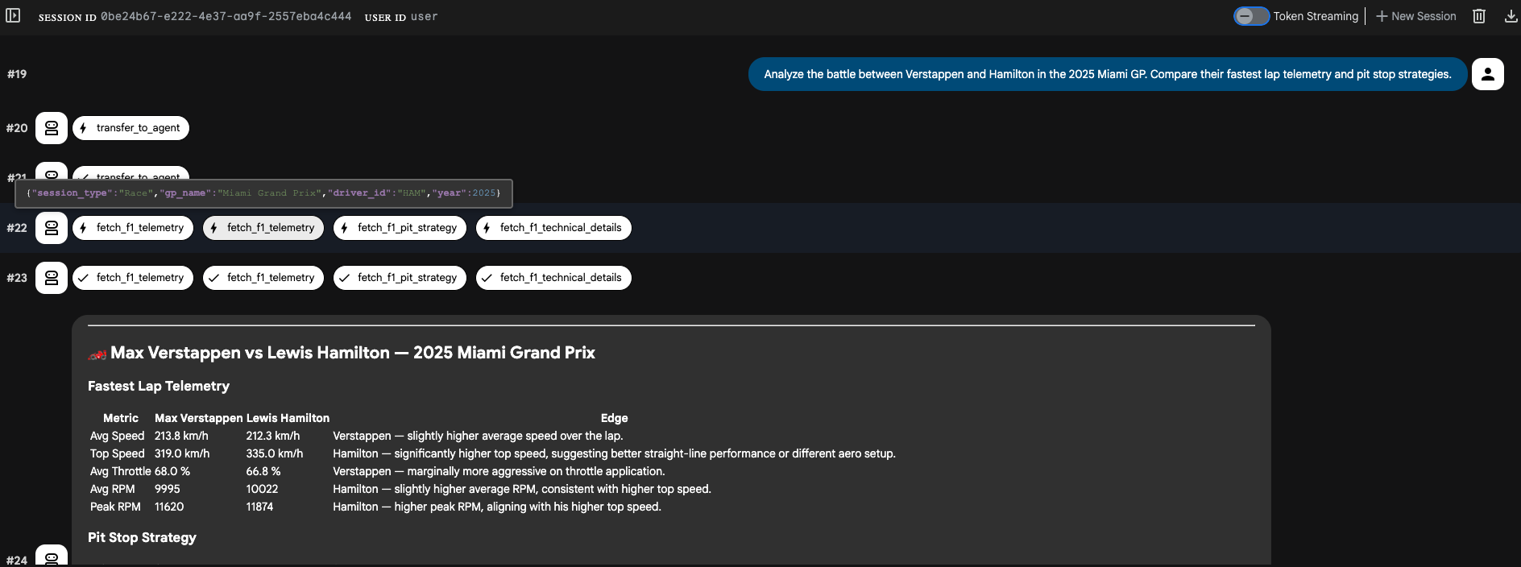

Slide 12
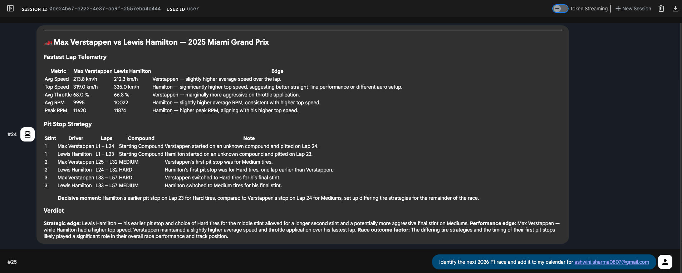

Slide 13
